Slide 1
Apple soil game
Joint Research Centre
#MissionSoil #EUmissions #HorizonEU

Slide 2

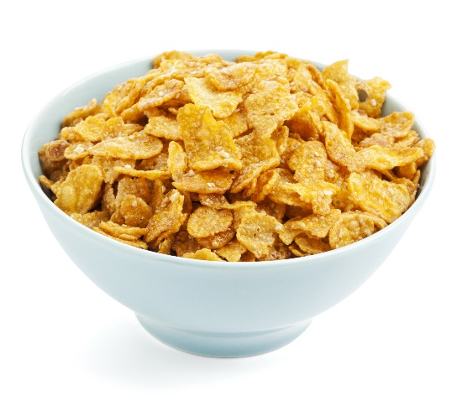
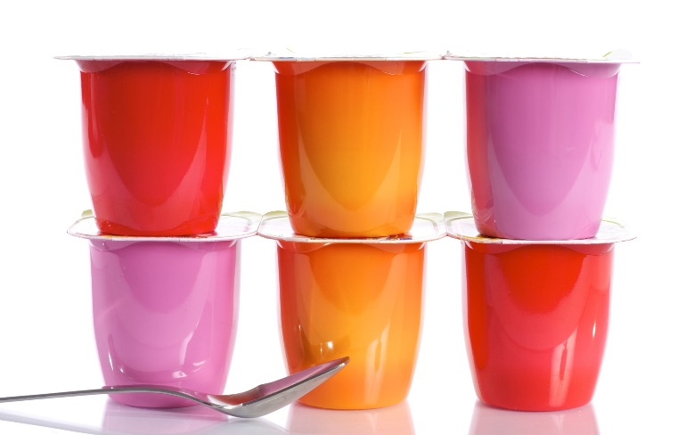
What did you have for breakfast this morning?

Slide 3


So, where do breakfast cereals, yogurt or fruit come from?
Supermarket?
A laboratory?
Cereal grains?
Trees and bushes?
Cows?

Slide 4

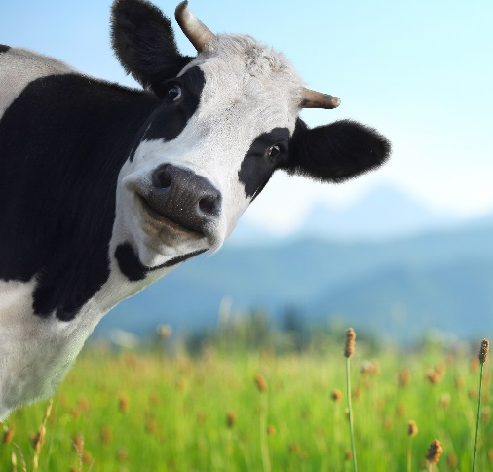
So, where do breakfast cereals, yogurt or fruit come from?
Yogurt is made from fermented milk. To produce milk, cows need to eat grass.
Breakfast cereals are made from the seeds of crops such as corn, wheat, oats and barley.
Fruit come from trees, bushes and small plants.
What do they have in common?
All plants need fertile soils to grow!

Slide 5
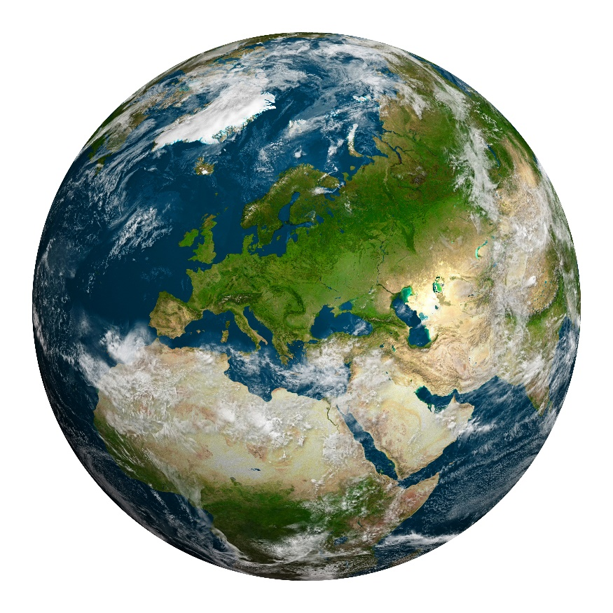
Do you know how much naturally fertile soil is there on our planet?
For what we eat?
For energy?
For our homes?
For our clothes?

Slide 6
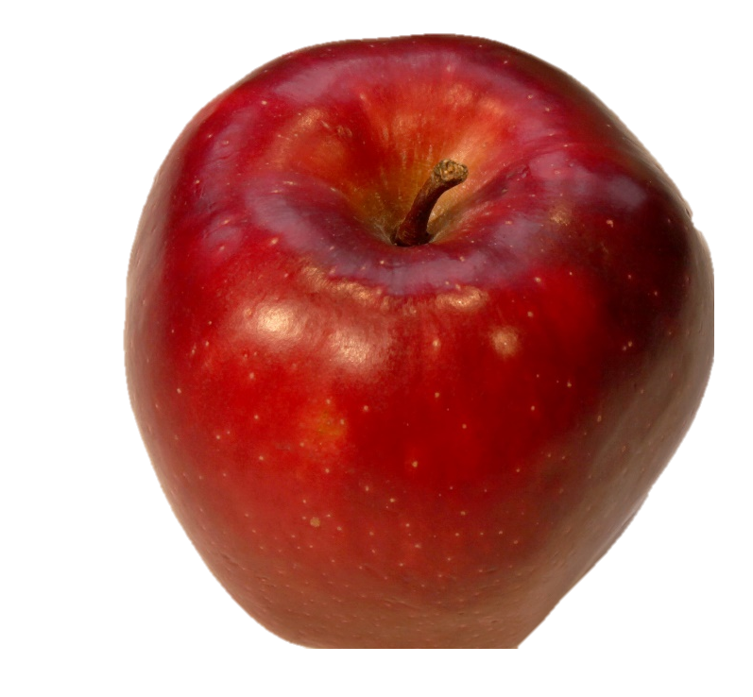
The apple metaphor
Notes:
Try to imagine
that our planet
Earth… is an apple!

Slide 7

And even if our planet is called Earth, how much of it is covered by water (oceans and seas – the blue part)?
11%
A.
66%
B.
88%
C.
Notes:
66% of the planet Earth is covered by water.
That means that about only a third of the planet is land!

Slide 8
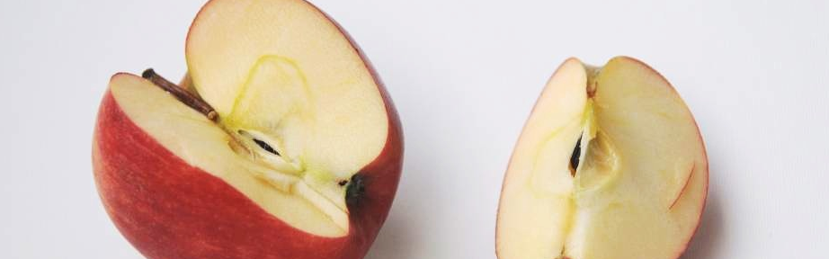
The Oceans (2/3)
The lands
(1/3)

Slide 9
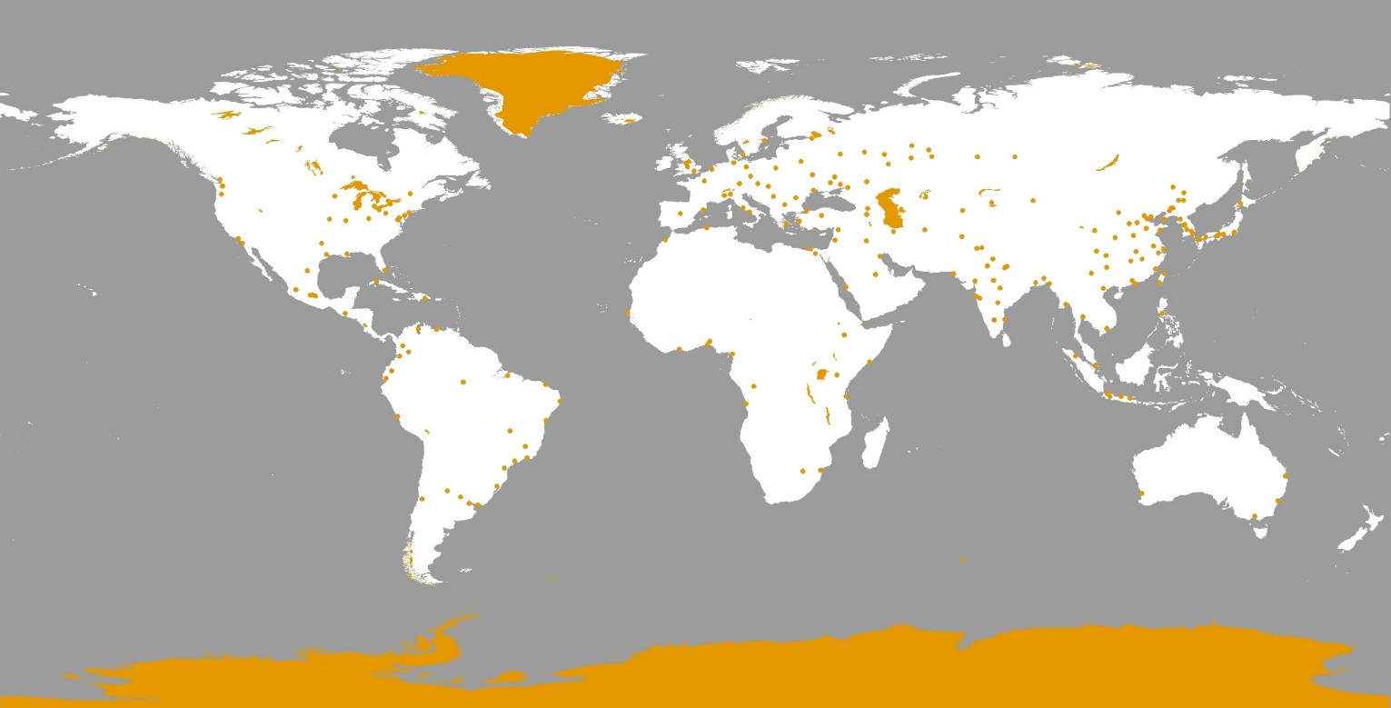
And how much land is not covered by soil?
For example, glaciers, lakes, towns and cities
10%
A.
15%
B.
19%
C.
Notes:
15%
10% = ice + 2% = lakes + 3% = built up areas
The orange colour shows you where they occur.
The Greenland Ice Cap and large lakes such as the Caspian Sea are obvious while the mega-cities of the planet show up as dots.
This means that we have to cut away 15% from our piece of apple (about 1/8th).

Slide 10
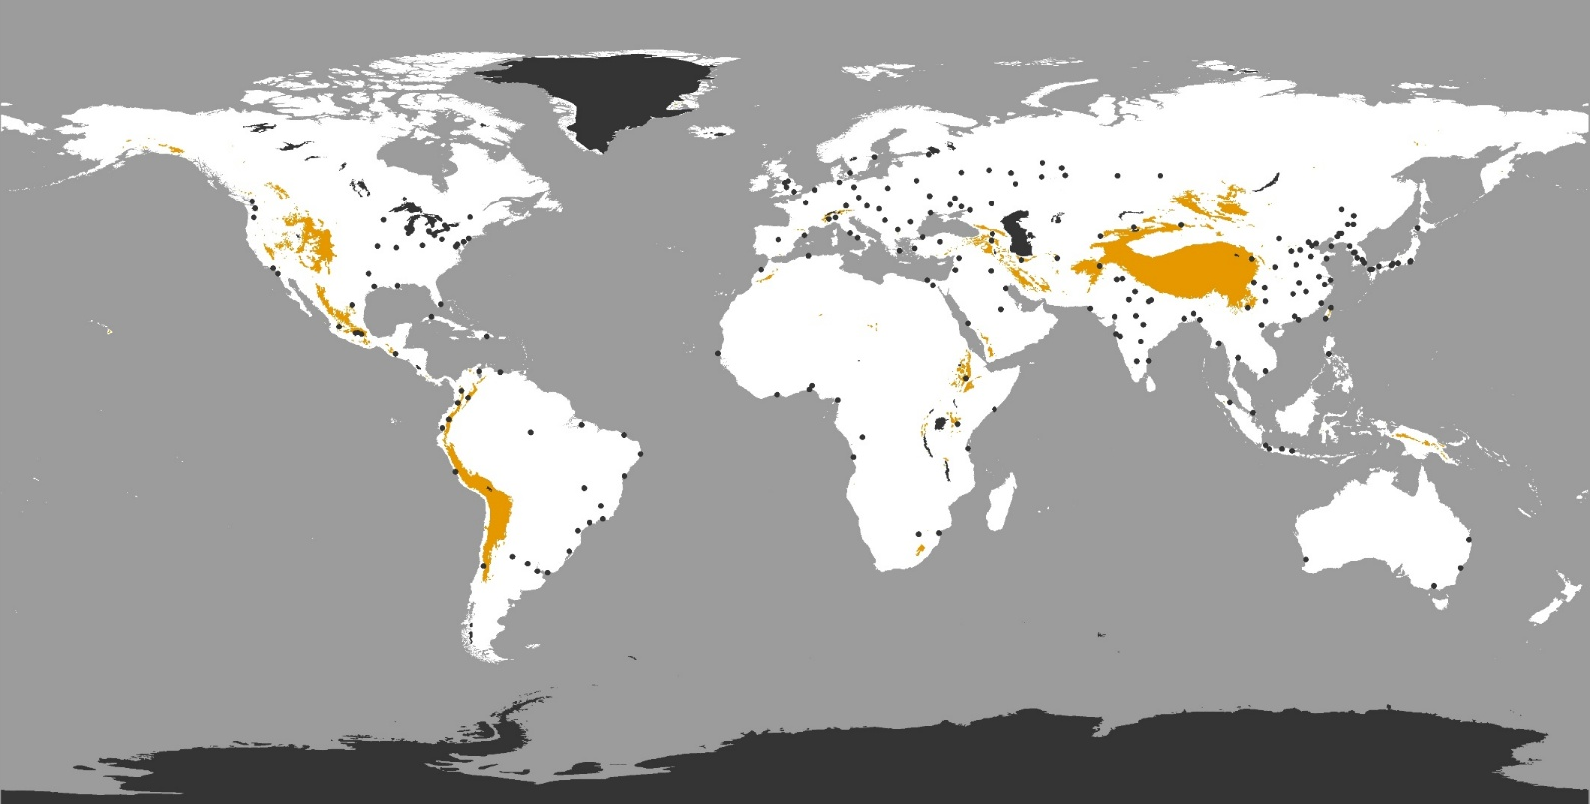
Try to guess… how much of the planet is covered by very high mountains?
6%
A.
10%
B.
12%
C.
Notes:
6%
Food production is limited because it’s too high, the land is too steep and the soils are rocky and shallow.
The orange colour shows you where the the major mountain ranges occur.
The Himalayas and Andes of South America are obvious.
The black colour is the area excluded by the previous question.
…we need to cut away 6% or about 1/20th of the apple.

Slide 11
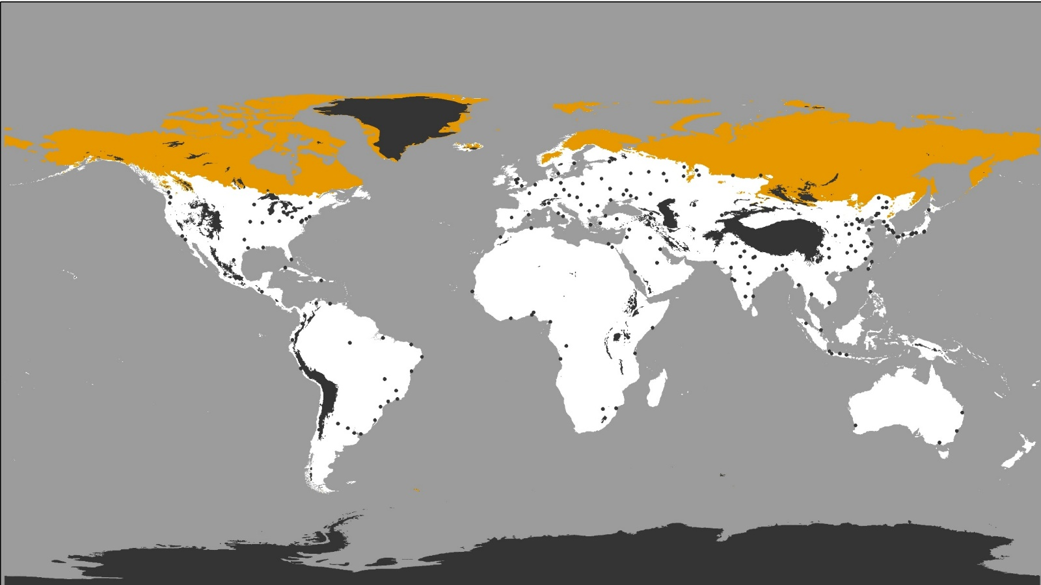
How much is too cold?
15%
A.
19%
B.
22%
C.
Notes:
15% too cold
Have you heard of permafrost? – this is soil that is always frozen.
The orange colour denotes where the average annual temperature is 0ºC.
Too cold for crops. This corresponds to the cold tundra regions.
The black colour is the area excluded by the previous questions.
…we need to cut 15%, which is about 1/8th of the apple

Slide 12
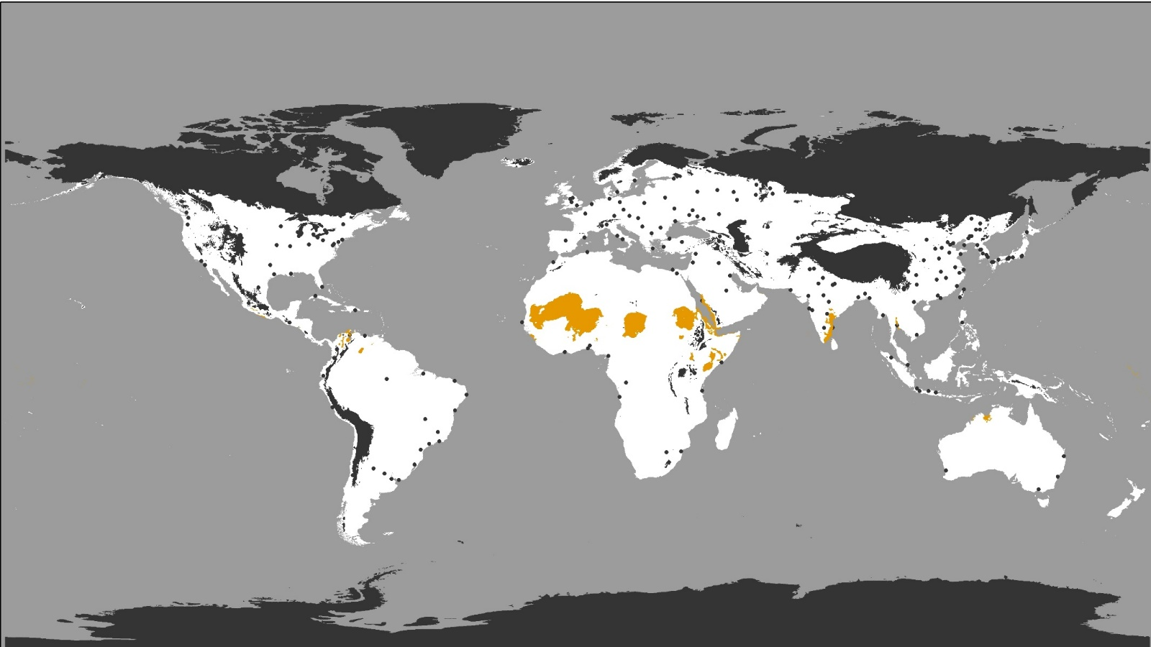
How much is too hot?
2%
A.
6%
B.
10%
C.
Notes:
2%
While it can be too cold for plants – it can also be too hot!
The orange colour denotes where the average annual temperature is > 28ºC.
These are the hottest places on Earth – too hot to grow crops.
The black colour is the area excluded by the previous questions.
…we need to cut 2%, which is about 1/50th or just a small sliver of the apple.

Slide 13
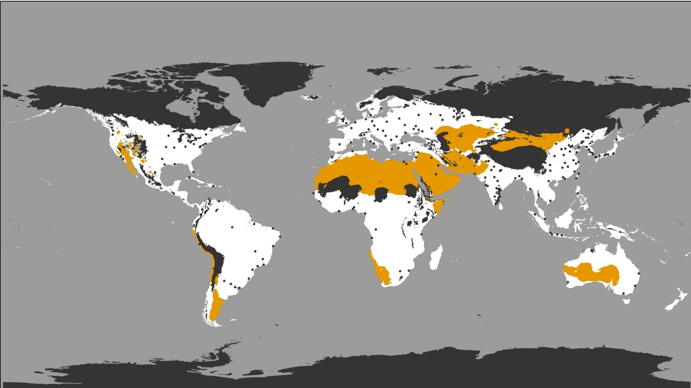
How much is too dry?
15%
A.
20%
B.
25%
C.
Notes:
20%
Apart from soil, plants also need water –
how much of the planet is desert?
The orange colour denotes where the average annual rainfall is < 200 mm.
These are deserts – too dry to grow crops without irrigation.
The black colour is the area excluded by the previous questions.
…we need to cut 20%, which is about 1/5th – quite a large bite of our apple!

Slide 14
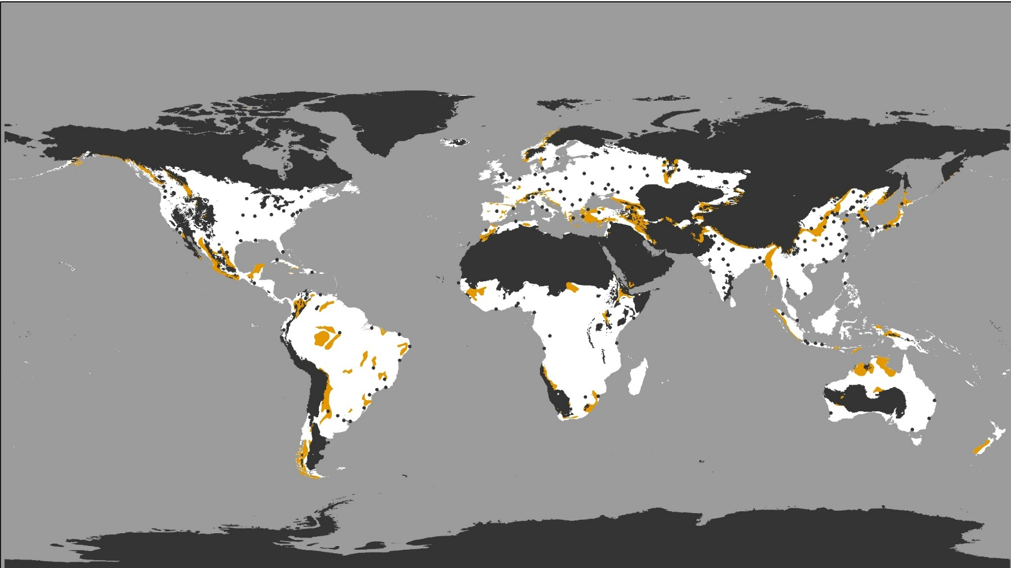
How much land is covered by thin and poorly developed soils?
1%
A.
3%
B.
6%
C.
Notes:
3%
Plants cannot grow if the soil has too much sodium, lime, gypsum, silica......
The orange colour indicates areas where the presence of salts and other componds resricts crop growth.
However, some of these areas can be used for grazing and non-food products.
The black colour is the area excluded by the previous questions.
…we need to cut 3%, which is about 1/30th – yet another small slice of our apple.

Slide 15
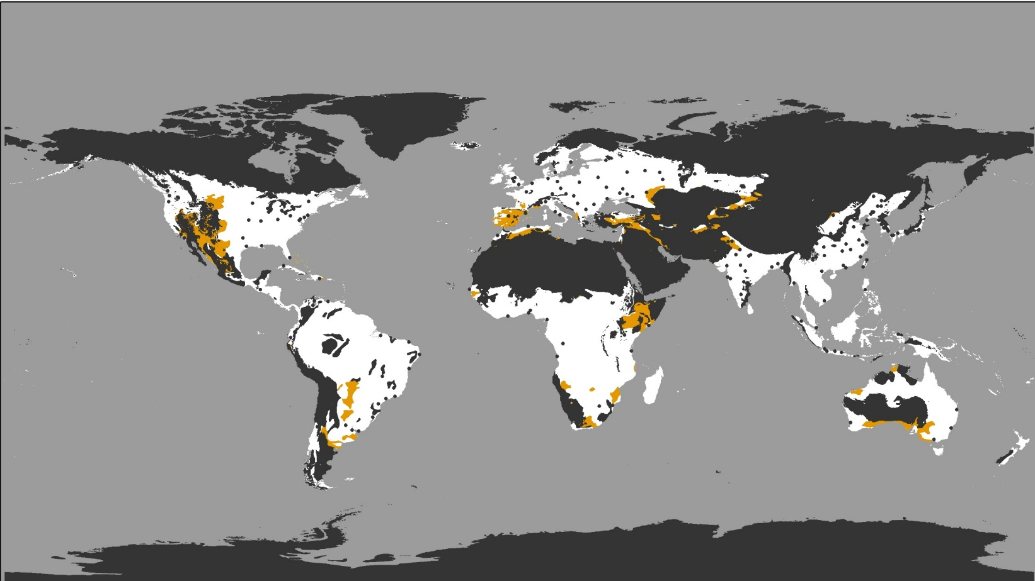
How much of the planet is covered by ‘salty’ soils?
1%
A.
3%
B.
8%
C.
Notes:
3%
Plants cannot grow if the soil has too much sodium, lime, gypsum, silica......
The orange colour indicates areas where the presence of salts and other componds resricts crop growth.
However, some of these areas can be used for grazing and non-food products.
The black colour is the area excluded by the previous questions.
…we need to cut 3%, which is about 1/30th – yet another small slice of our apple.

Slide 16
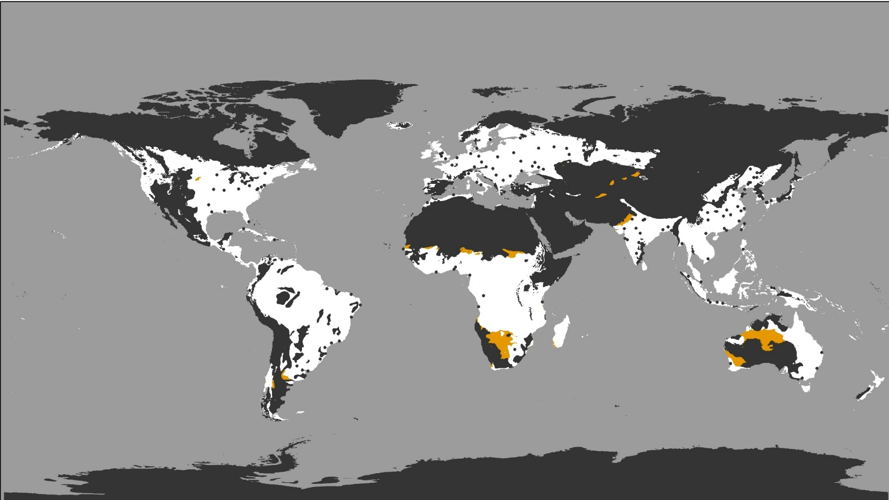
How much of the earth is too sandy?
2%
A.
6%
B.
8%
C.
Notes:
2%
Sandy soils don’t contain many nutrients needed by crops
and unlike clay soils, don’t store water when it doesn’t rain – they do not retain water very well.
The orange colour denotes sandy soils in dryish climates. These free drainng soils may cause problems in dry seasons and droughts.
The black colour is the area excluded by the previous questions.
…we need to cut 2%, which is about 1/50th – another small slice of our apple.

Slide 17
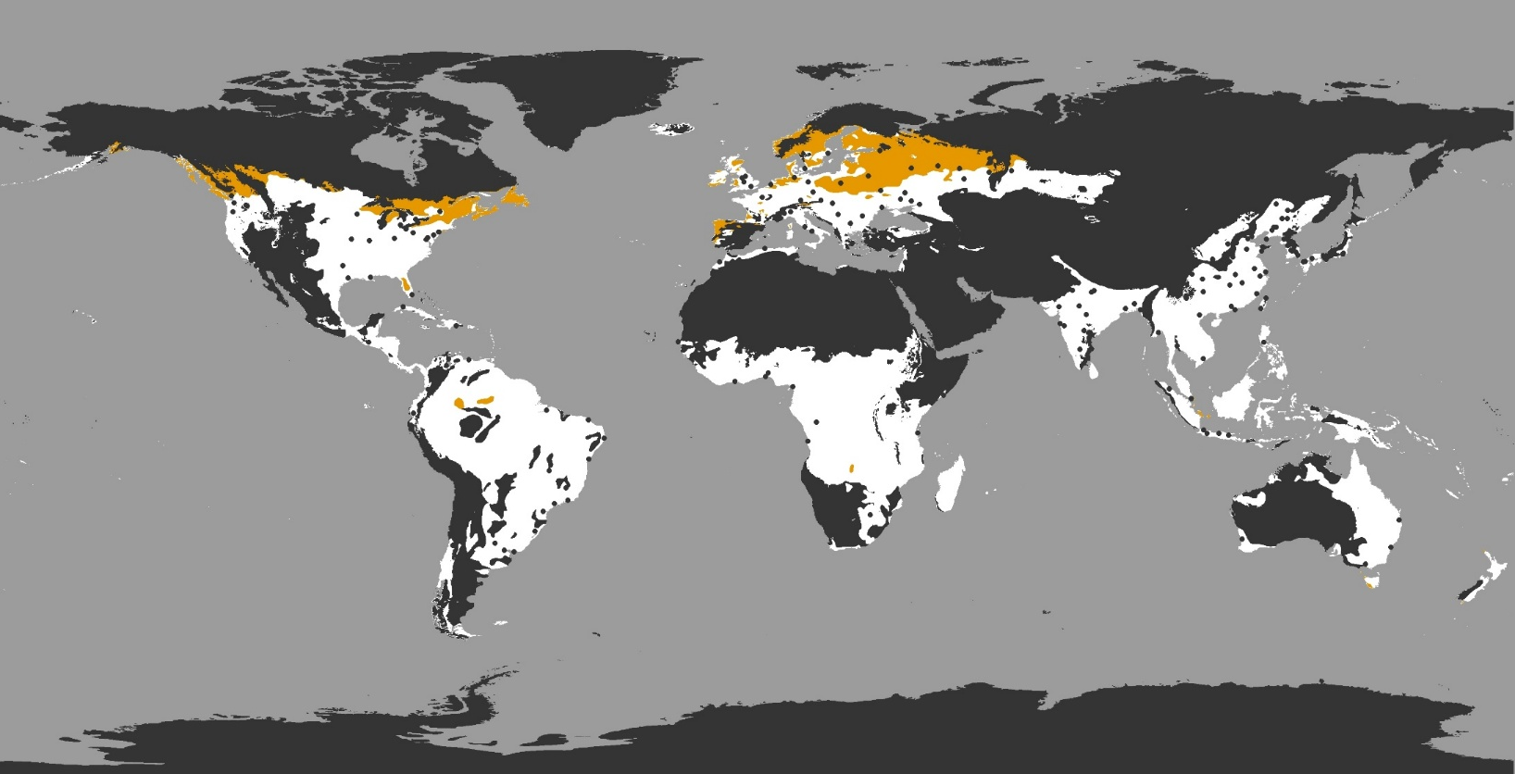
How much is covered by conifer forests?
10%
A.
15%
B.
18%
C.
Notes:
10%
Forests provide timber, store carbon and provide important habitats which we need to preserve. Also many forest soils are not suitable for intensive food production.
The orange colour denotes areas under temperate coniferous forests with generally acidic soils.
The black colour is the area excluded by the previous questions.
…we need to cut 10%, which is a 1/10th – more than what people think.

Slide 18
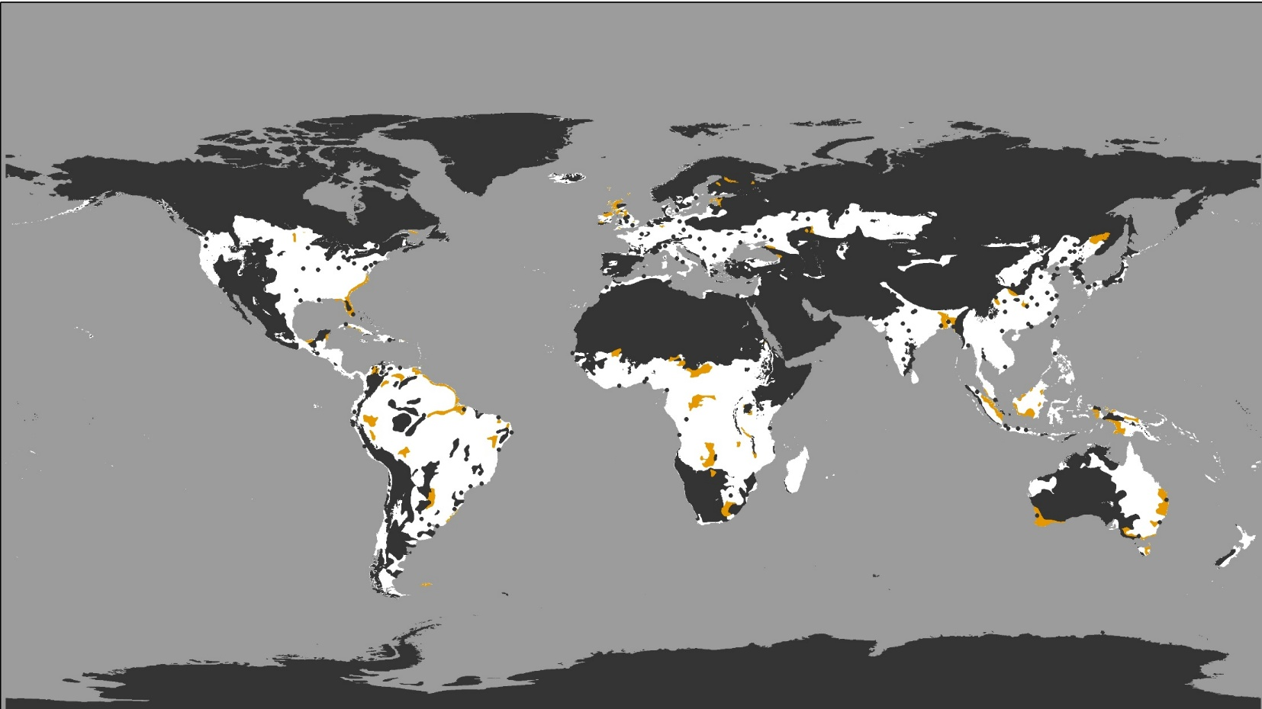
How much is too wet or saturated?
2%
A.
5%
B.
9%
C.
Notes:
2%
Most plants cannot grow if the soil is very wet for long periods. Peatlands are important habitiats and store carbon.
The orange colour denotes soils that are permanently waterlogged or saturated by water for significant periods of time. Drainage is required to cultivate crops on these soils. However, many of these areas are important ecologically.
The black colour is the area excluded by the previous questions.
…we need to cut 2%, which is about 1/50th – another small slice but locally, this can be really significant.

Slide 19
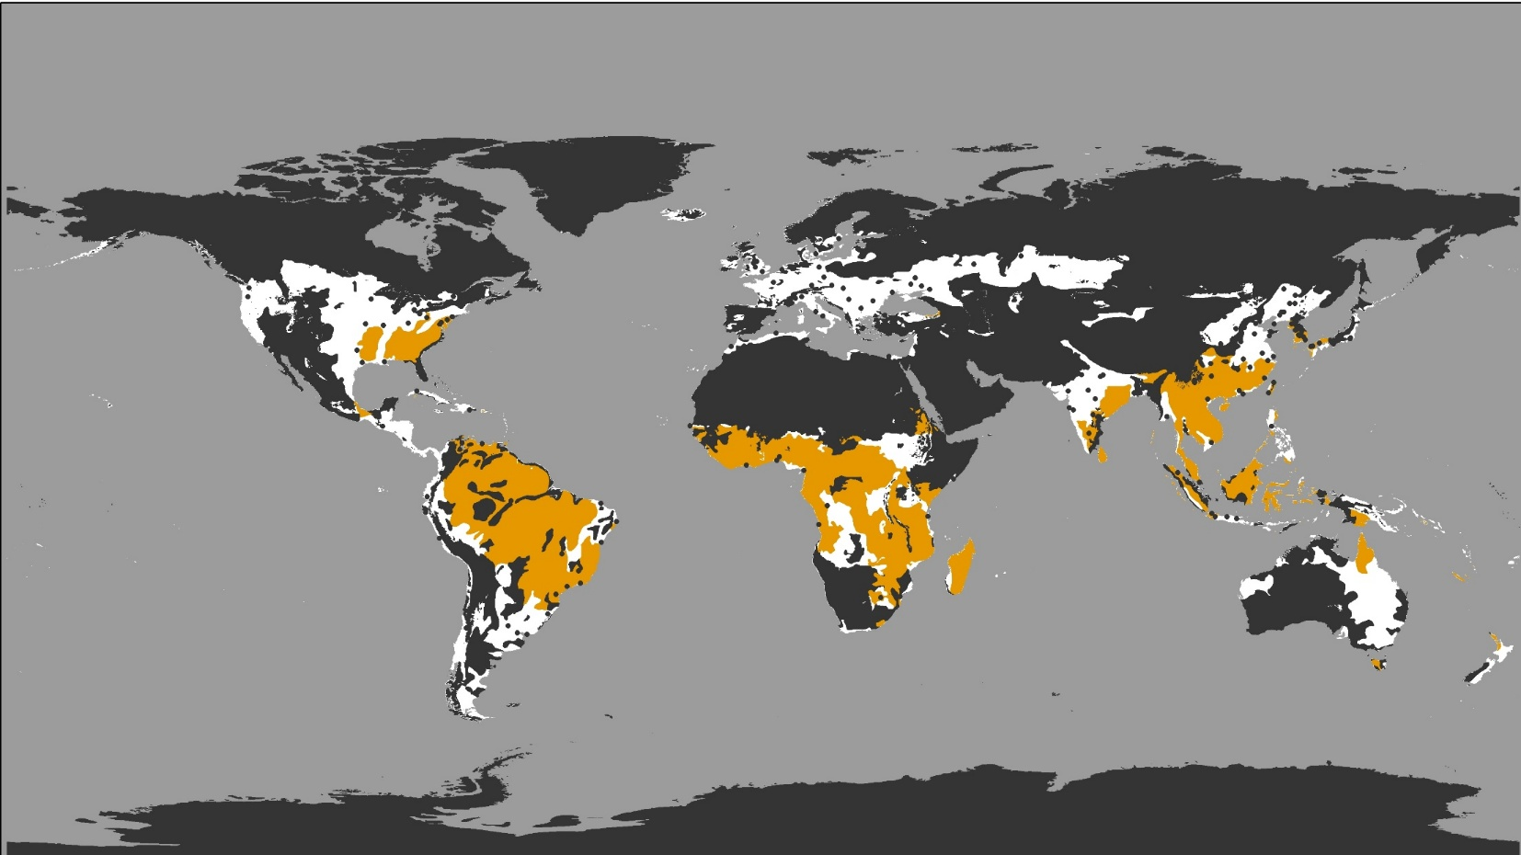
How much is covered by tropical soils?
Acidic, low in nutrients and organic matter
8%
A.
10%
B.
19%
C.
Notes:
10%
Many tropical soils are very acidic, contain high amounts of aluminium and iron, low amounts of organic matter, which makes food cultivation difficult.
…we need to cut 10%, which is 1/10th – another large bite from the apple. Crops can be grown in these soils but careful management is required to prevent erosion and nutrient loss.

Slide 20
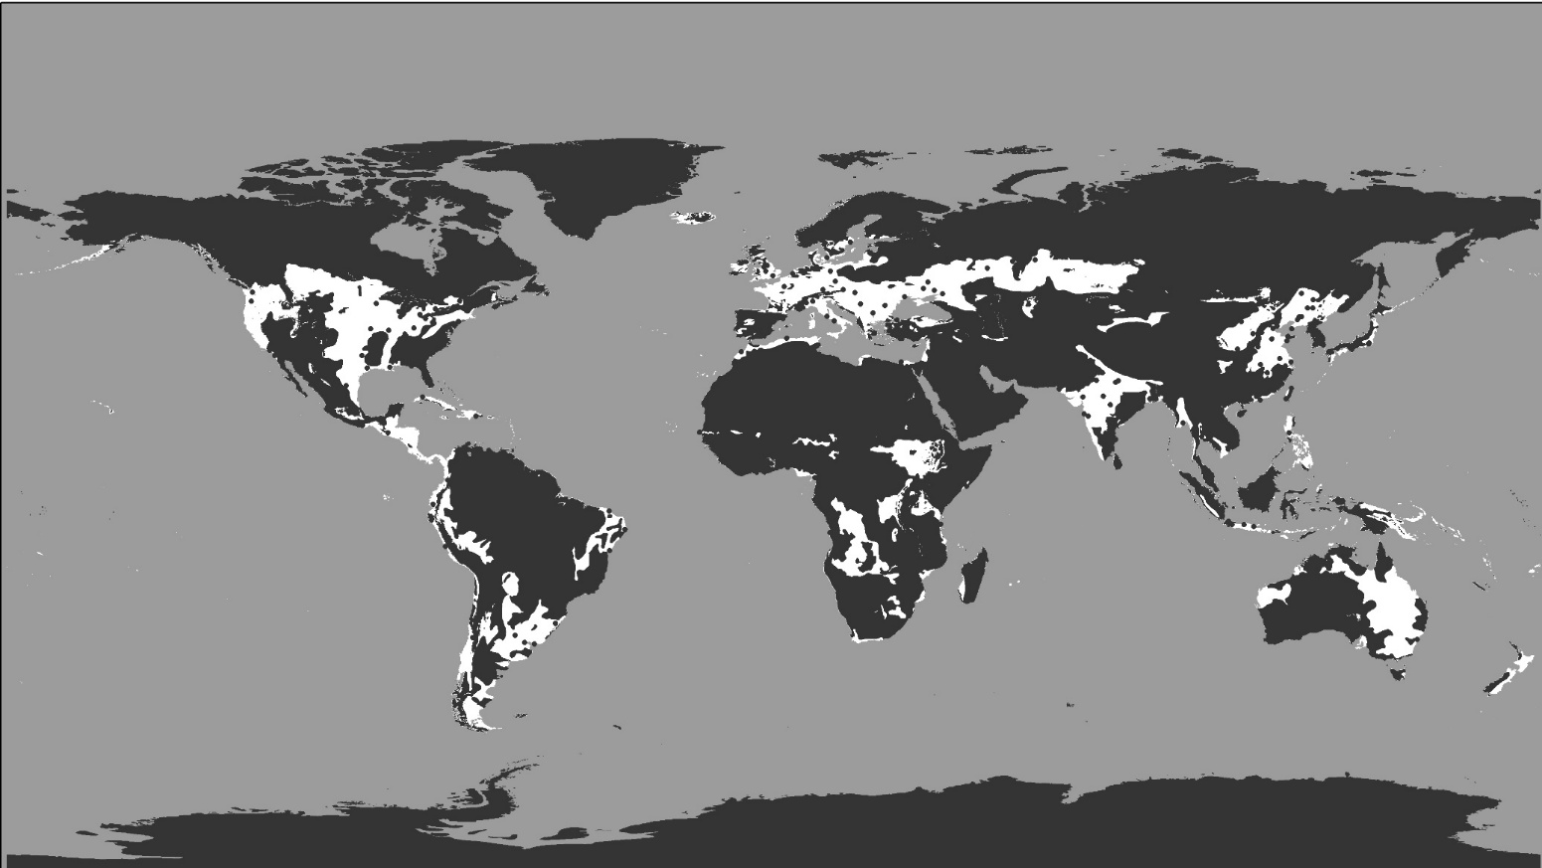
So, after all this, how much land is left?
Only around 10-15% of the land surface!
To feed 9 billion people!
Notes:
As you can see, in Europe we are quite fortunate.
However, the situation in other parts of the world is not as good.
black areas can be used to grow food but require additional effort (water, fertilizer, lime, etc...)

Slide 21
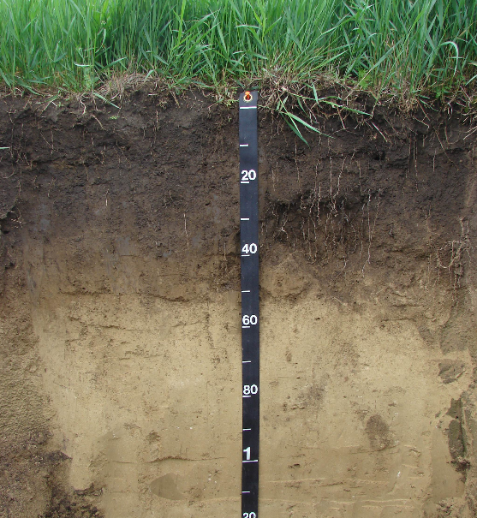
BUT! Soils are shallow…
…Like the skin of the planet.
Usually less then 2m deep!

Slide 22
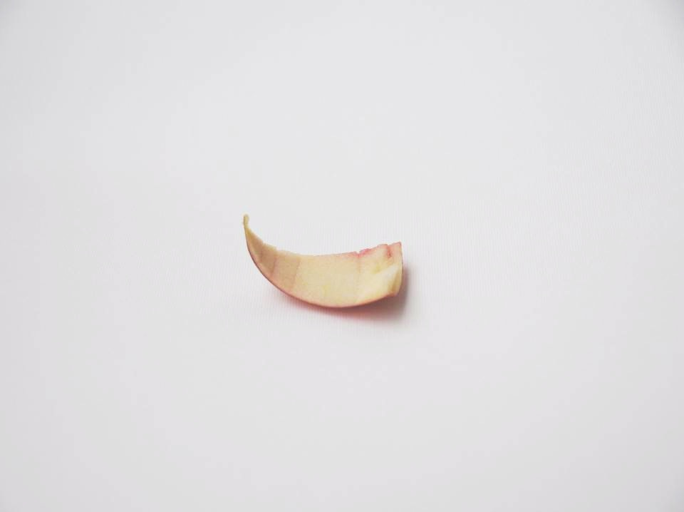
So in reality, we are talking only about the skin of the apple!
This small piece then represents all the naturally fertile land on the planet than can be used to readily cultivate food

Slide 23
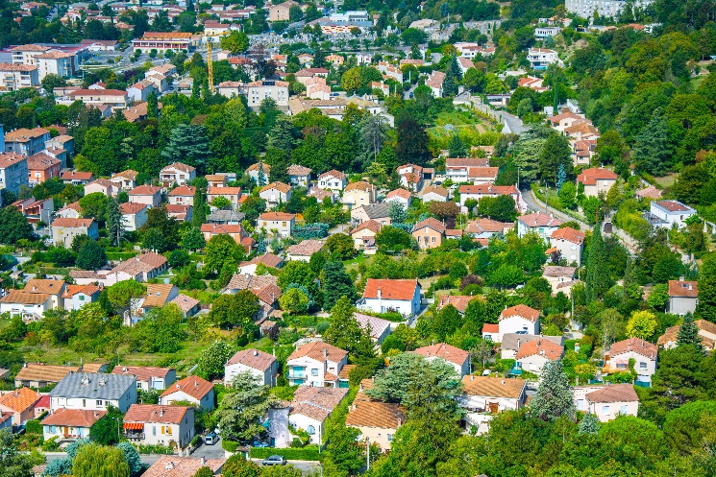
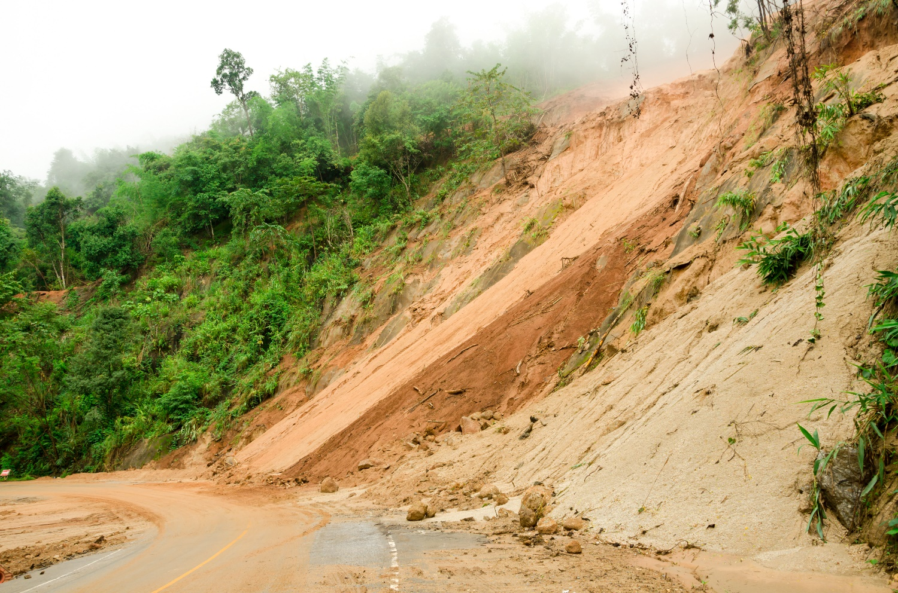
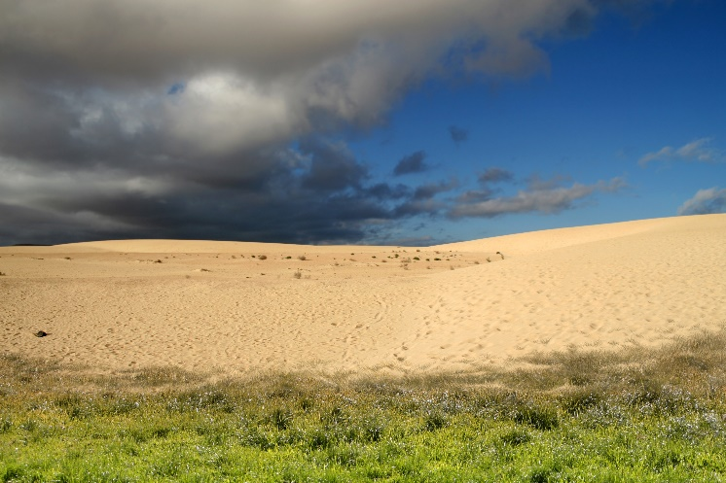
And then, there are threats to soil…
…climate change, sealing, erosion, contamination, landslides, increase in salts, decrease in organic matter, loss of biodiversity, compaction…

Slide 24
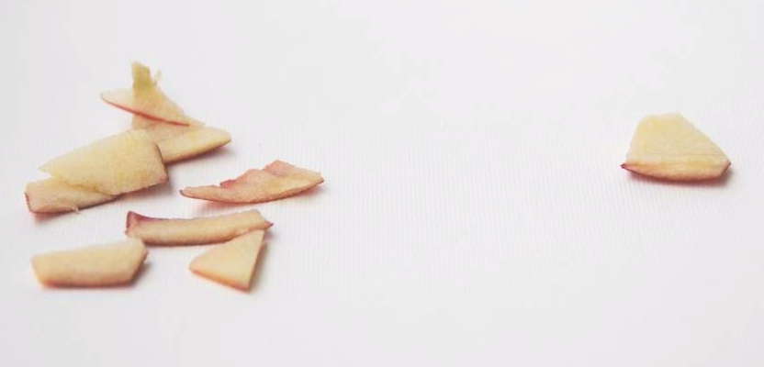
This means that the remaining soil is under pressure…
…and is being continuously nibbled away

Slide 25
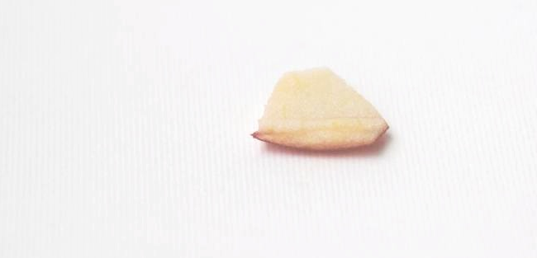
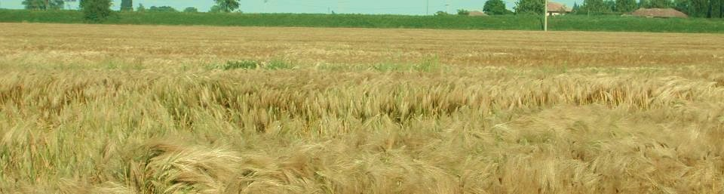
Survival of humankind is based on this.

Slide 26
Sustainable management and effective conservation practices are essential to maintain soil fertility and thus ensure secure safe and nutritious food for us and for the future generations.

Slide 27
http://ec.europa.eu/horizon-europe
#HorizonEU #EUmissions #MissionSoil

Slide 28
Photo credits:
Orange juice © CSKN - Fotolia
Yogurts © AlcelVision - Fotolia
Cornflakes © eyewave - Fotolia
Cow © Dudarev Mikhail - Fotolia
Earth © Nadalina – Fotolia
Threat urbanisation © Alexi Tauzin – Fotolia
Threat desertification © Giordano Aita - Fotolia
Threat landslides© Kedsirin - Fotolia
Maps:
© European Commission, Joint Research Centre

Slide 29





Keep in touch
http://ec.europa.eu/horizon-europe
EUAgri
https://esdac.jrc.ec.europa.eu/
euagri
@EUAgri
euagrifood
Notes:
Delete/update as appropriate

